Slide 1
Tonight’s Required Resources
Please come in and get set up.
Azure Cloud Account
Putty
Files from GitHub: https://github.com/MassStreetAnalytics/Hands-On-Hadoop

Slide 2

Hands On: Introduction to the Hadoop Ecosystem
Bob Wakefield
Principal
bob@MassStreet.net
Twitter: @BobLovesData

Slide 3
Who is Mass Street?
Boutique data consultancy
We work on data problems big or “small”
Free Big Data training

Slide 4



Mass Street Partnerships and Capability
Hortonworks Partner
Confluent Partner
ARG Back Office

Slide 5
Bob’s Background
IT professional 16 years
Currently working as a Data Engineer
Education
BS Business Admin (MIS) from KState
MBA (finance concentration) from KU
Coursework in Mathematics at Washburn
Graduate certificate Data Science from Rockhurst
Addicted to everything data

Slide 6
My Experience With Hadoop
Trained by MetaScale. (Rip MetaScale)
Running a seven node lab cluster for three years
Built because sandboxes are limited and tired of waiting for AWS
Used for clients and R&D
Cluster specs:
CentOS 7
Hortonworks Data Platform 2.6.1
1 Name Node
3 Data Nodes
3 Node Kafka cluster
Total HD space: 19TB
Total RAM: 196 GB
Total cost ~ $3,000

Slide 7
Follow Me!
Personal Twitter: @BobLovesData
Company Twitter: @MassStreet
Blog: DataDrivenPerspectives.com
Website: www.MassStreet.net
Facebook: @MassStreetAnalyticsLLC

Slide 8
KC Learn Big Data Objectives
Educate people about what you can do with all the new technology surrounding data.
Grow the big data career field.
Teach skills not products

Slide 9
KC Learn Big Data Objectives

Slide 10
This Evening’s Learning Objectives
Get familiar with Ambari
Get familiar with Hive
Demonstrate BI for Big Data
If there is time, go over a real world use case.
Always expect crazy at lab time!

Slide 11
Logistics
Modalities of material delivery.
We need a better meeting place. I’m open to ideas!

Slide 12
Upcoming MeetUps
September: Architecting your first Hadoop implementation
October: Joint MeetUp with Data Science KC. Up and Running with Spark and R
November: Joint MeetUp with Kansas City Apache Spark MeetUp. Practicing IoT skills with Satori
December: Survey of common data science algorithms.

Slide 13
This Evenings Objectives
Hadoop ecosystem.
MapReduce Concepts.
Basic understanding of Data Science Principals.

Slide 14

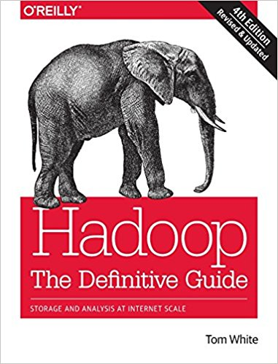
Resources For This Evening’s Material: Books
Programming Hive: Data Warehouse and Query Language for Hadoop
Hadoop: The Definitive Guide: Storage and Analysis at Internet Scale

Slide 15
Resources For This Evening’s Material: Online Classes
Udemy course: Comprehensive Course Hadoop Analytic Tool: Apache Hive
No good Hadoop admin classes online
Links to resources can be found in the Resources folder of the GitHub repo for this class.
https://github.com/MassStreetAnalytics/Hands-On-Hadoop

Slide 16
I want to do big data work. What do I need to know?
Basic understanding of Hadoop ecosystem.
Basic understanding of MapReduce Concepts.
Basic understanding of Data Science Principals.

Slide 17
Pick A Path
Data Science
Data Engineering
Data Interpreter?

Slide 18
Basic Skills For Each Role
Data Scientist
Full understanding of DS/ML concepts
R or Python
Data Engineer
Java or Scala or Python or R
Build tools like Maven, Ant, or Gradle
Source Control preferably GitHub
Full understanding of MapReduce
Full understanding of Hadoop Ecosystem
Full understanding of NoSQL
Full understanding of MPP DBs

Slide 19
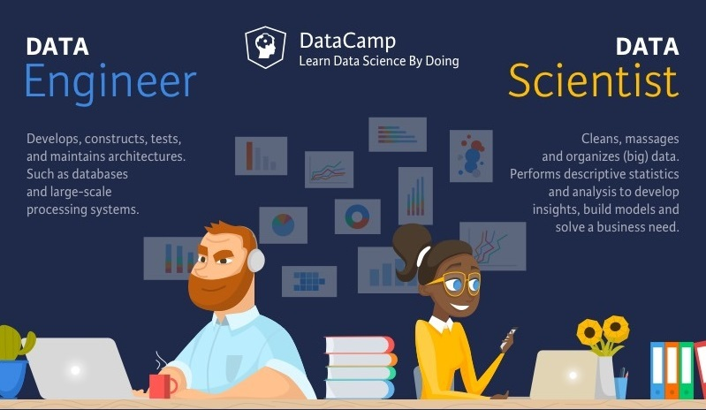

Slide 20
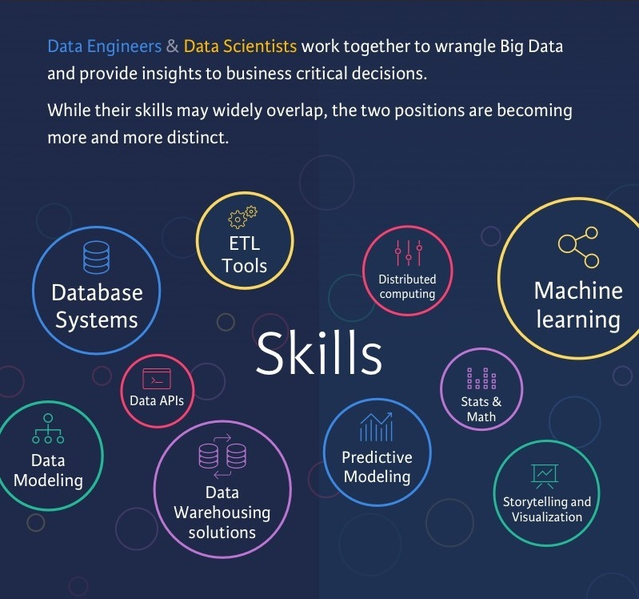

Slide 21
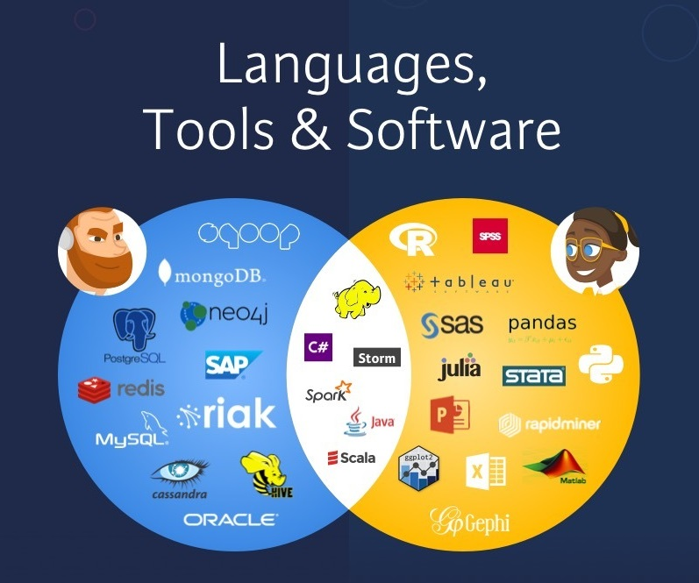

Slide 22


Slide 23
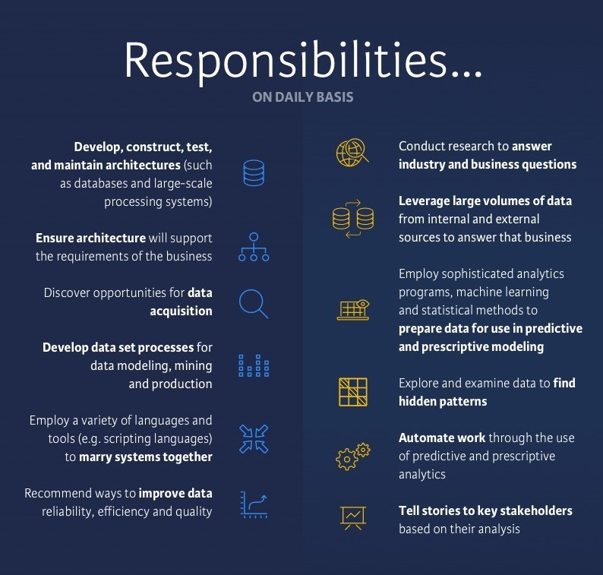

Slide 24
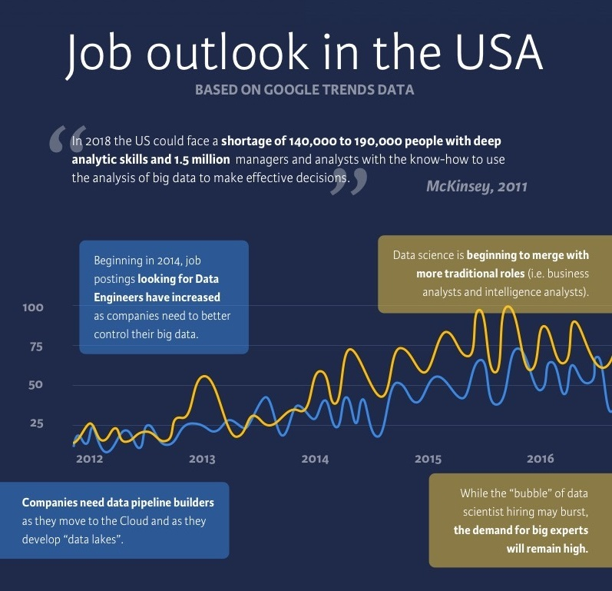

Slide 25
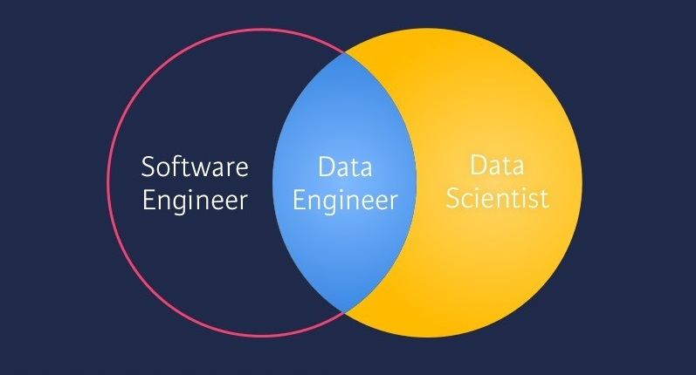

Slide 26
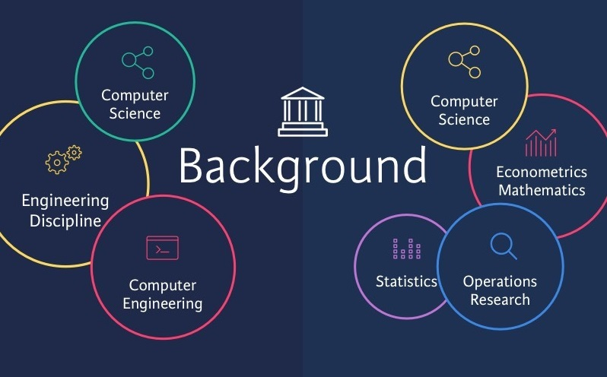

Slide 27
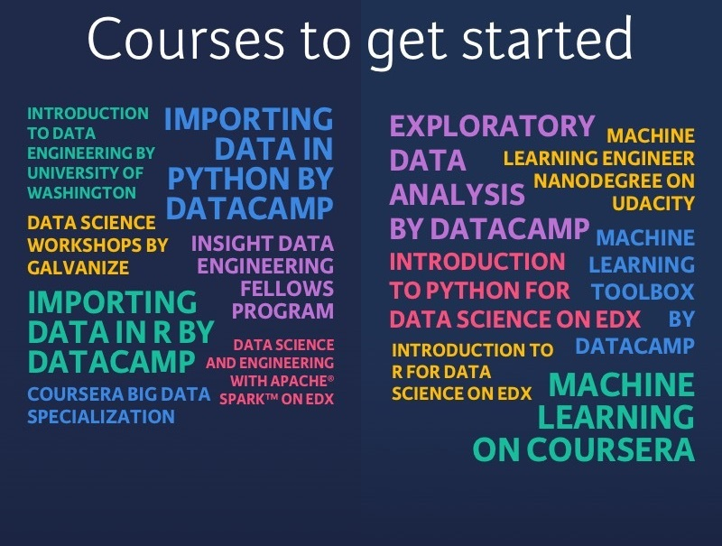

Slide 28
What is Hadoop?
Provides distributed fault tolerant data storage
Provides linear scalability on commodity hardware
Translation: Take all of your data, throw it across a bunch of cheap machines, and analyze it. Get more data? Add more machines

Slide 29
Common Hadoop Use Cases
Easier analysis of big data
Lower TCO of data
Offloading ETL workloads
Data warehousing
Data lakes
Backbone of various advanced data systems

Slide 30
















Slide 31
What these things do
Sqoop – ETL tool
Pig – data flow language
Drill/HAWQ – SQL on Hadoop
Knox/Ranger – Security
Zookeeper – Coordination
Spark – In memory computing
Kafka – Distributed Pub/Sub messaging

Slide 32
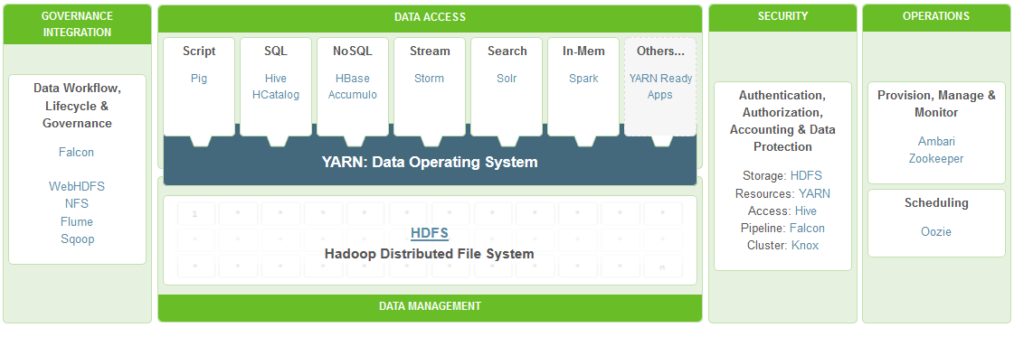
Photo Credit: Hortonworks website
It’s like a child’s erector set!

Slide 33
HDFS
Hadoop Distributed File System
The data operating system!
Manages nodes in the cluster
Scalable and highly fault tolerant

Slide 34
HDFS
Mechanics
Cuts up data into blocks and spreads across nodes
Replicates blocks across nodes
Process optimization

Slide 35
MapReduce
This is how Google indexes the web
It’s a low level programming framework for pulling data out of the cluster
Communicates with HDFS
Designed for batch processing
Can use any language to write MapReduce jobs
How does MR work? Pffffft!

Slide 36
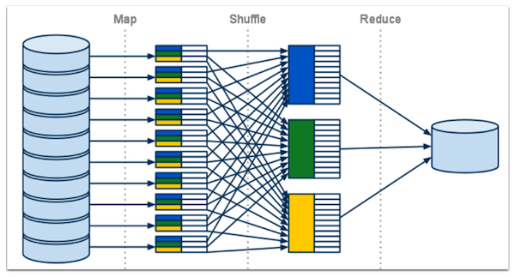

Slide 37
Hive
Hadoop warehouse solution
SQLesque language called Hive Query Language
Adds structure to unstructured data
Provides a window into HDFS

Slide 38
Hive
Writes MapReduce behind the scenes (sorta)
Should be used for OLAP task
Queries aren’t fast, just faster than normal
You can connect through ODBC/JDBC
Which means you can work with Hive using standard BI tools

Slide 39
Tez
Tez generalizes the MapReduce paradigm to a more powerful framework for executing a complex DAG (directed acyclic graph) of tasks for near real-time big data processing.

Slide 40
Bob’s Super Crashy Crash Course In SQL
SQL – Structured Query Language
SQL is how you retrieve data from relational databases
Each statement consist of a minimum of three elements
SELECT
FROM
WHERE

Slide 41
Bob’s Super Crashy Crash Course In SQL
In the old world, data is stored in two dimensional tables; rows and columns
There are rules about how this information is stored.
Data is usually modeled as a set of relationships
These relationships can be thought of in terms of parent child.

Slide 42
Bob’s Super Crashy Crash Course In SQL
There are all kinds of relationships.
Many to one. Simplest and most common.
One to one.
Many to many.

Slide 43
Bob’s Super Crashy Crash Course In SQL
Normally, each record is identified by some value called a key.
The are all kinds of keys but the most important are:
Primary Keys
Foreign Keys

Slide 44
Bob’s Super Crashy Crash Course In SQL
Primary Keys uniquely identify a record
Foreign Keys are the primary key of a parent record.

Slide 45
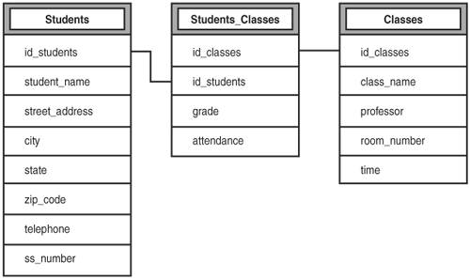
Bob’s Super Crashy Crash Course In SQL

Slide 46
A brief history of SQL on Hadoop
Data on HDFS is not stored in a relational style.
NoSQL
Data retrieval very difficult
Attempts to make HDFS talk SQL
HAWQ
Drill
Opinion: Efforts are floundering because of the rise of MPP databases

Slide 47
Tonight’s Scenario
You work in a large organization with a lot of data but it is stored in old world relational databases. You need to analyze this data but there are over a billion records and your queries are incredibly slow. You convince your boss to let you try Hadoop. You spin up a cluster and get to work.

Slide 48
Analyst Task
Get your data into HDFS.
Get your data into Hive.
Run some initial queries on the data.
Share your analysis.
(Make sure you destroy your cloud instance!)

